Slide 1
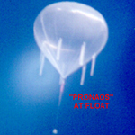
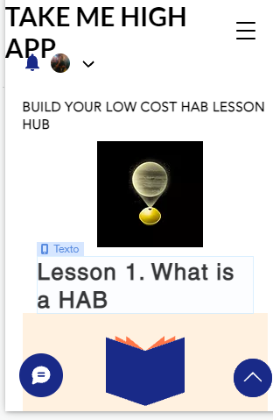
TAKE ME HIGH APP
Space seems a very far and difficult activity for common people
We are proposing to develop an App which could guide the user (from middle schoolers to elder people) across all the process to make a succesfull launching of their own low cost HAB, and reach the near space (20 km at least).
This App, will have numerous tabs with lessons, each one addressing subjects as planning, preparation, launch, tracking, and recovery . Including mission planning, generating a bill of materials, links to tracking and weather resources.
We want to help get Access to Space for All

Slide 2
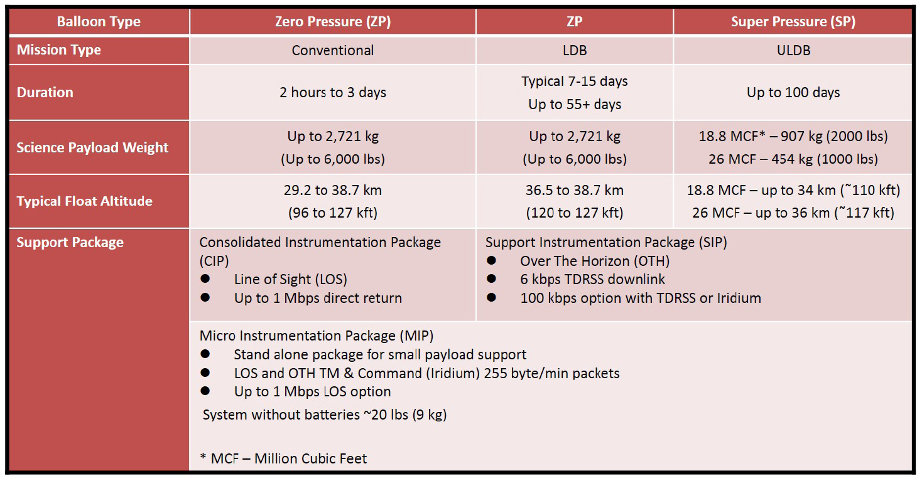
Balloon Operational Data
NASA's Balloon Operational Support Capability chart.

Slide 3
Launching a HAB Mission
Steps:
Planning
Buying
Building
Contact local authorities (mainly aviation ATC and city hall)
Launching
Tracking
Recovery

Slide 4
Low Cost HAB BOM
ITEM
Latex 98 “ Balloon
Rope
Helium
Payload
Pocket Tracker for Android (GPS)
Reflector

